Slide 1
Training Material for Management: Driving Cultural Change
This training material is designed for the management team to introduce the new, BRC-compliant approach to our Product Safety Culture.
Module 1: Why We Are Changing
The Challenge with Our Old Approach
Our previous "Food Safety and Quality Culture Plan" was a great starting point, but it had key limitations. It was largely a conceptual document that described our intentions rather than providing an auditable action plan. Critically, its measurement system relied on a subjective 0,1,2,3 scale that only measured whether an activity was completed, not its actual impact on employee behavior or product safety. This approach presented a significant risk during audits because it could not provide objective proof of a positive cultural shift.
Conceptual Document
Subjective Measurement
Audit Risk
Described intentions rather than providing an auditable action plan
Used a 0,1,2,3 scale that only measured activity completion
Could not provide objective proof of a positive cultural shift

Slide 2
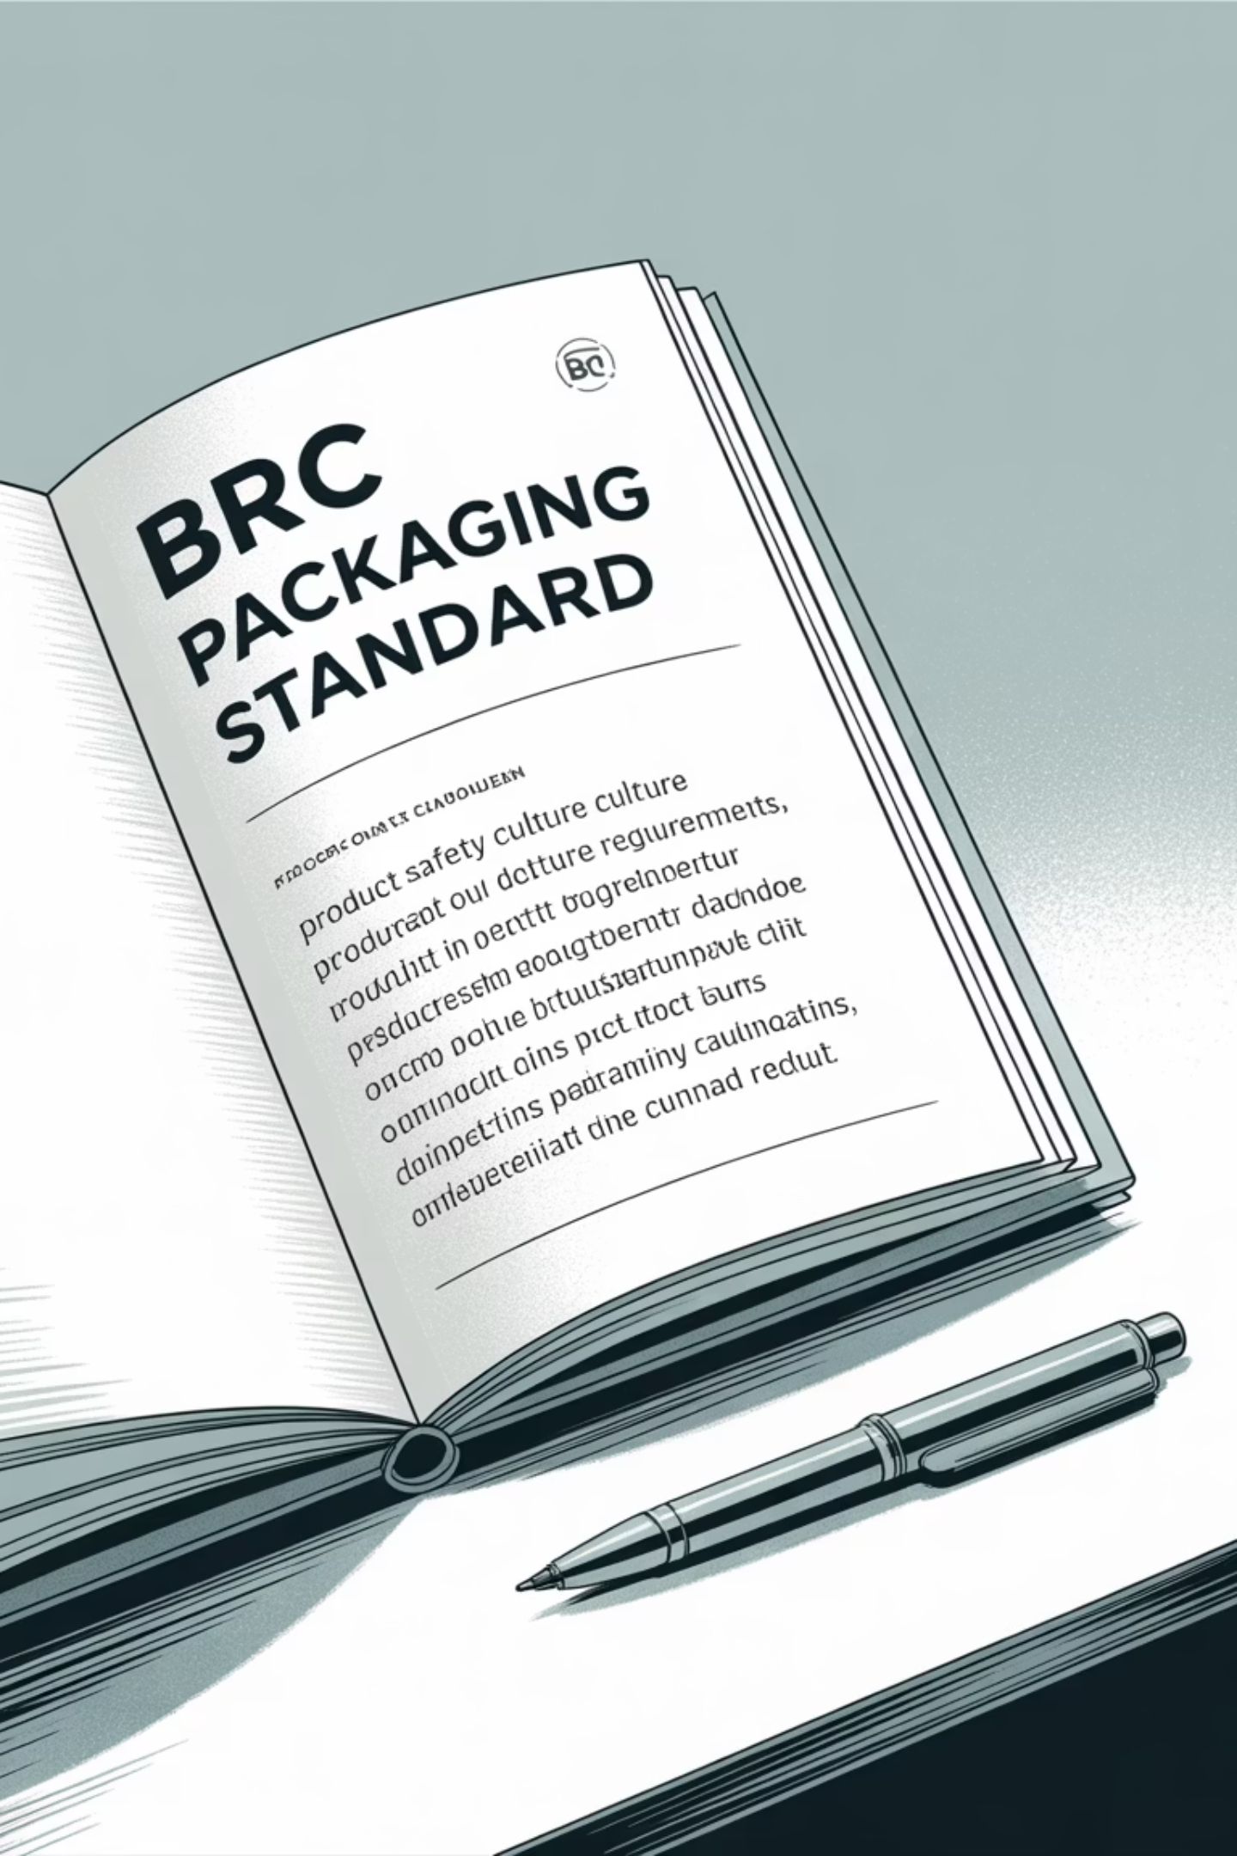
The New BRC Requirement
The BRC Packaging Standard update is highly prescriptive. It demands that senior management defines a clear, effective plan for a product safety culture that includes:
1
2
Defined Activities
An Action Plan
Specifically designed around communication, training, feedback, required behaviors, and performance measurement.
Indicating how activities will be undertaken, when they will be completed, and how their effectiveness will be measured.
3
A Review Process
A formal, documented review of the plan's effectiveness at least annually.
Our updated procedure is a shift from a descriptive document to an auditable management system that meets these requirements.

Slide 3










Module 2: The New Approach
The new approach is built on a foundation of proactive, data-driven management and is centered on five core pillars mandated by the BRC Standard.
Training
Communication
Ensuring competence, not just knowledge
Two-way dialogue between management and employees
Feedback
Formal mechanisms for employee input
Measurement
Objective KPIs to track cultural maturity
Behaviors
Defined actions that improve product safety

Slide 4
The Five Core Pillars in Detail
Communication
Feedback
We will move from one-way messaging to a two-way dialogue. By using formal channels (e.g. whatsapp, confidential reporting, annual survey) for employee feedback to ensure our message is understood and acted upon.
A formal feedback mechanism has been implemented, such as a confidential portal. This demonstrates that we are actively soliciting employee input and that their concerns are not only received but acted upon.
Behaviors (Main Change)
Training
The behaviors have been defined required to maintain and improve product safety, such as proactive reporting and consistent practice. As managers, your role is to lead by example and demonstrate a personal commitment to these behaviors.
Training must go beyond simply providing knowledge; it must ensure competence. Maintain formal training with assessments to verify that employees can apply what they have learned. This ensures that training has a lasting impact on behavior.

Slide 5


Measurement
The subjective scoring system has been replaced with a dashboard of objective, quantitative Key Performance Indicators (KPIs). We will measure both proactive indicators (e.g., near-miss reporting rates, employee feedback participation) and reactive indicators (e.g., customer complaints, non-conformities). This provides a clear, data-driven picture of our cultural maturity.
Proactive Indicators
Reactive Indicators
Near-miss reporting rates
Customer complaints
Employee feedback participation
Non-conformities
Training completion and competency
Audit findings

Slide 6
Communication
Communication
Share product safety information regularly through established channels (e.g. WhatsApp group, noticeboards, briefings) so all employees receive and understand key messages.
Operations Manager
10 times/Annum
1 = Messages irregular or little engagement2 = Regular messages, partial engagement3 = Regular messages, high engagement and interaction

Slide 7
Training
Training
Provide annual food safety training for all staff, ensure new employees are trained at induction, and confirm competence through refresher sessions or practical checks.
Operations Manager/Director
Annual
1 = Planned / Minimal /Little or no verification of competency.2 = Implemented / Partial/Competency checks done but not consistent across all staff.3 = Effective / Embedded/Competency checks confirm staff can apply knowledge.

Slide 8
Feedback
Feedback
Collect employee feedback on product safety through surveys or direct reporting, and ensure responses are reviewed, acted upon, and communicated back to staff.
Operations Manager/Director
Annual
1 = Average section scores are below 2.0 (out of 3 or 5 depending on survey design).Responses show inconsistent leadership commitment, weak communication, or lack of empowerment.Culture is still mostly compliance-driven (people do the minimum, often only when observed).2 = Average section scores are between 2.0 and 3.5. Employees generally understand their role, training is mostly effective, and some proactive behaviours are visible. Feedback mechanisms exist, but impact is uneven (e.g. some actions from feedback, but not consistently).3 = Average section scores are above 3.5. Leadership visibly prioritizes safety, communication is open, and employees feel empowered.Proactive reporting, accountability, and continuous learning are normalised behaviours

Slide 9
Behaviours
Behaviours
Define and communicate expected food safety behaviours, with managers reinforcing them through daily leadership so staff apply them consistently without supervision.
Operations Manager/Director
Annual & Ongoing
1 = Behaviours defined but not widely visible or reinforced. Staff mostly comply when supervised; lapses when not observed.2 = Behaviours are communicated and partially adopted across teams. Most staff follow safety practices, but not always without prompting. Supervisors occasionally reinforce behaviours, but not systematically.3 = Behaviours are widely demonstrated without supervision. Strong culture of proactive reporting, accountability, and empowerment.Staff consistently adhere to protocols and encourage peers.

Slide 10
Performance Measurement
Performance Measurement
The site will track and review KPIs on product safety, legality, and quality (e.g. complaints, audit findings, incidents, compliance checks) at set intervals to monitor culture and drive improvement.
Senior Leadership
Annual
1 = Key metrics (complaints, audit NCs, incidents, legal compliance) are not consistently tracked or reviewed. Little or no evidence that performance data drives improvement.2 = Metrics are tracked regularly (monthly/quarterly) and reported to management. Evidence of progress in some areas (e.g. fewer NCs), but not across all.3 = Metrics on safety, legality, and quality are systematically tracked and reviewed. Results show continuous improvement trends (e.g. fewer complaints, stronger audit outcomes, full compliance).

Slide 11
Module 3: Leadership Role
As a manager, you are the cornerstone of this culture approach. Your visible commitment is the most important factor in shaping employee behavior.
Lead by Example
Empowerment
Consistently follow all protocols, such as proper handwashing and wearing the correct attire. Employees are more likely to adopt safe practices if they see management doing the same.
Foster a trusting and open environment where employees feel empowered to raise concerns or report issues without fear of reprisal. Empower them to take ownership and lead positive change.
Reinforce Behaviors
Utilize Data
Use consistent, clear, and fair reinforcement to shape behaviours. Acknowledge and reward positive actions and provide constructive feedback for areas of improvement.
Use the new KPIs to identify trends, address gaps, and inform strategic decisions. Regularly review the data from the Action Plan and discuss it with your teams.
By embracing this data-driven approach, we will not only achieve BRC compliance but also create a genuinely resilient and high-performing product safety culture.

